Slide 1
Introduction to Compliant Database DevOps
Chris Unwin, Compliant DevOps Specialist, Redgate
Notes:
Welcome to today’s session on Compliant Database DevOps!
First, let’s start with a couple of housekeeping items. All attendees are on mute during the webinar, but we want to hear your questions so if you have any during the course of this presentation, please enter it into your question box and we’ll make sure we leave plenty of time at the end of the webinar to go through them. This webinar is also being recorded and we’ll follow up with a copy of the recording as well as the slides over the next couple of days.

Slide 2


Your Presenter
Chris Unwin
Data Privacy and Protection Specialist
Chris.Unwin@red-gate.com
/in/christopherunwincambridge/
DBAle on Spotify and iTunes
Notes:
[Introduce yourself]
Articles
DBAle
3 years at Redgate

Slide 3
About Redgate
300
2m
19
202,000
Redgaters and counting
years old
customers
SQL Server Central and Simple Talk users
91%
4m
1147
68
of the Fortune 100 use our tools
website visits each year
product releases last year
User Groups sponsored last year
Notes:
[Talk about Redgate]

Slide 4
Agenda
What is DevOps?
Extending DevOps practices to the database
Where is the risk in this process?
Expanding DevOps to include compliance
Notes:
So what are we focusing on today. We’ll quickly remind ourselves of what devops is and what it means in the context of databases. then we’ll move on to talking about the principles that any database shops should follow in order to implement a successful DevOps pipeline.

Slide 5
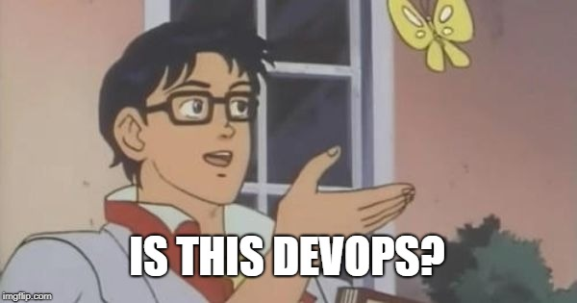
A DevOps fallacy
MANAGERS
DEVELOPERS
VENDORS
MORE FEATURES
AUTOMATION
TOOLS

Slide 6
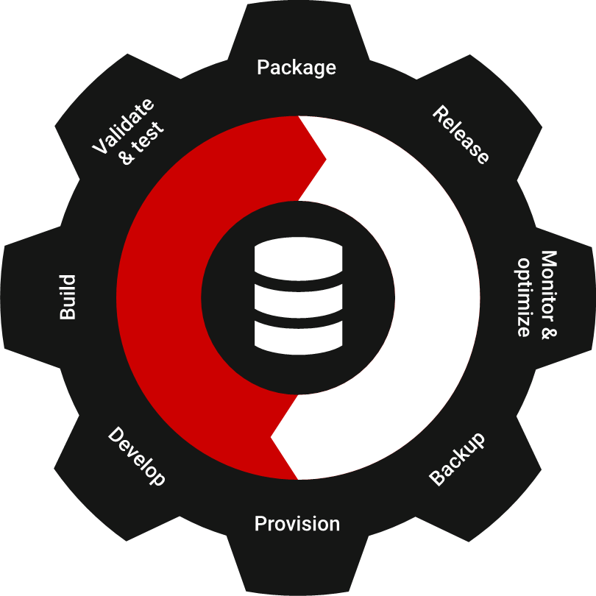
“DevOps is the union of people, process, and products to enable continuous delivery of value to our end users.”
Donovan Brown,
Principal DevOps Program Manager, Microsoft
Notes:
Before we look at the 4 principles, let’s make sure everyone’s on the same page as to what DevOps is because if you ask 10 different people what DevOps is you’re going to get 10 different answers.
But here’s the definition of DevOps from Microsoft’s point of view that hopefully resonates with you all. So ….
The key things to take a note of here is the words People, process and products. What this means is that you can’t just go and buy some DevOps tools and say we’re a DevOps shop now or you can’t sit your devs and DBAs next to each other and say we removed the walls between devs and Ops so we’re doing DevOps. DevOps is not something that you implement once and you’re done. It’s a journey that requires continuous improvement in these 3 areas. Having the right people and processes is key to the success of any DevOps initiative. And then tooling comes next.
The other important thing to note here is we’re talking about delivery of value not features or more code. Because The ultimate goal of any DevOps initiative should be to deliver more value to your customers quicker in order to stay ahead of competition and be able to easily accommodate new market changes.

Slide 7
Extending DevOps to your database provides:
Repeatability of processes
Greater predictability over releases
Faster speed of response to change
Greater reliability of the release process
Overall faster delivery of business value
Notes:
Now, let’s talk about DevOps for databases.
So, hopefully by now we all understand the benefits of DevOps and here we’ve highlighted some of them.
One common trend that I see from working with different organizations is that most application teams have modernized their development and delivery process and have introduced automated testing and releases whereas development and release processes around databases are still neglected and most organizations still see the databases as a bottleneck to faster and more frequent delivery of software.
In many organizations, DBAs spend majority of their time reviewing database change scripts that can take anywhere from hours to even days depending on their release frequency and in a lot of cases they have to rework the database scripts multiple times until they’re considered as production ready. Part of this is because it’s difficult to treat database like code. There’s a lot of pressure on DBAs to maintain the integrity and safety of their data in their databases so they can’t just do a simple replace like we do on the code side. another issue is that databases are not stored as text that you can easily source control and put through an automated build and release process.
Bottom line is that we understand the challenges associated with modernizing development and delivery processes for databases and we believe that with the right processes and tooling you can definitely do achieve a true DevOps process for databases and that’s what we’re going to show you next.

Slide 8
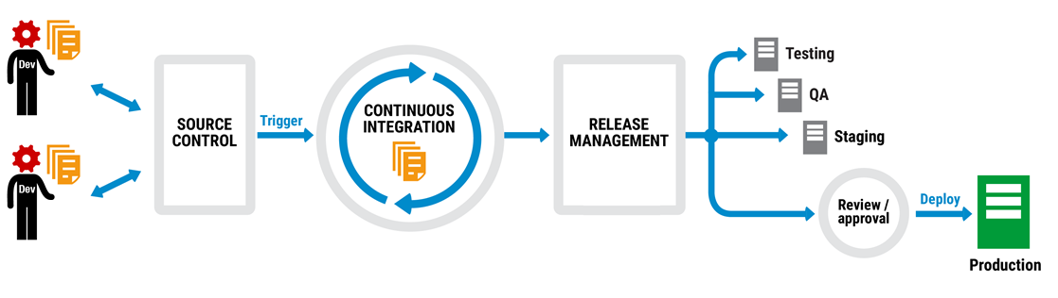
Application automated deployment pipeline
Notes:
So We already said that DevOps is a broad concept and requires the right culture and right people but it’s also about having the right processes and a lot of automation to replace a lot of the manual repetitive tasks that are time consuming and error prone. So, here on the screen we have a typical change management pipeline for code that starts from the left where we have developers making changes and committing them into source control which is one of the fundamental principles to a successful devops pipeline and we’re going to talk about that in greater details.
So, again most of your are probably already doing this for your app code but to summarise [talk through slide]
So for the application this is a complete process, and we like good process because…

Slide 9
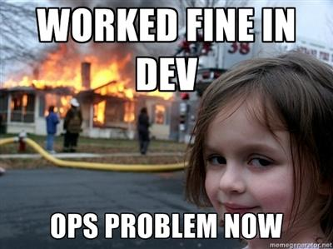
A complete process means less of this…
Notes:
[Read slide title]
So how drastically does that diagram change when we include the database?

Slide 10
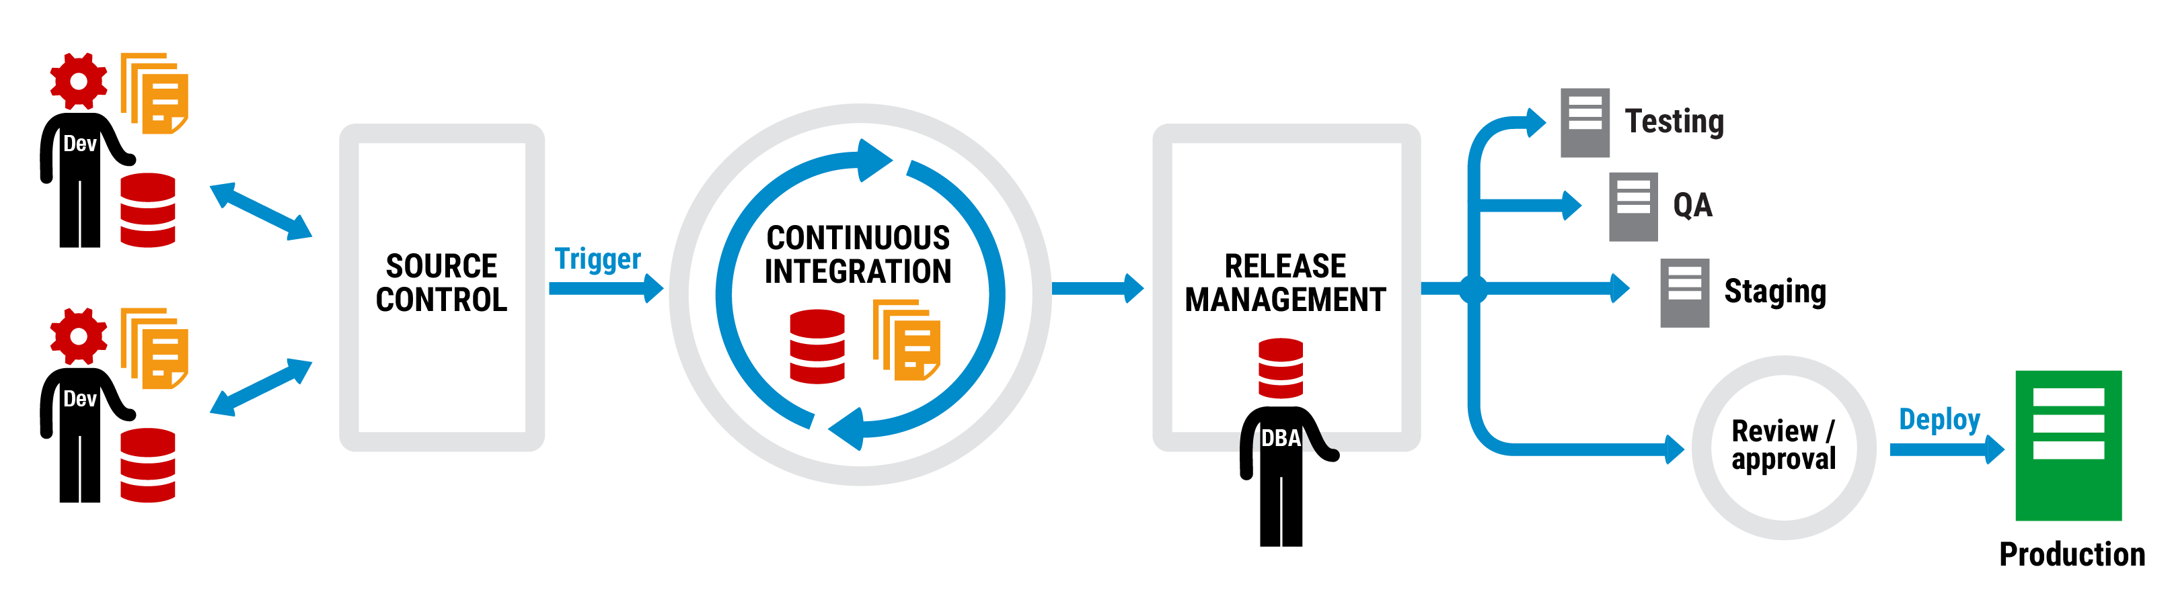
Application and database deployment pipeline
Notes:
Well surprisingly not so much.
At Redgate, we believe that the same principles should be applied to databases without having to change much on what we’re already doing with the app code – so we believe that the same techniques and steps should be taken but of course with some slight tweaking.
[Talk through diagram]
But there was something missing from that diagram, something that underpins everything that we as data professionals do… the data. How does that impact a DevOps process?

Slide 11
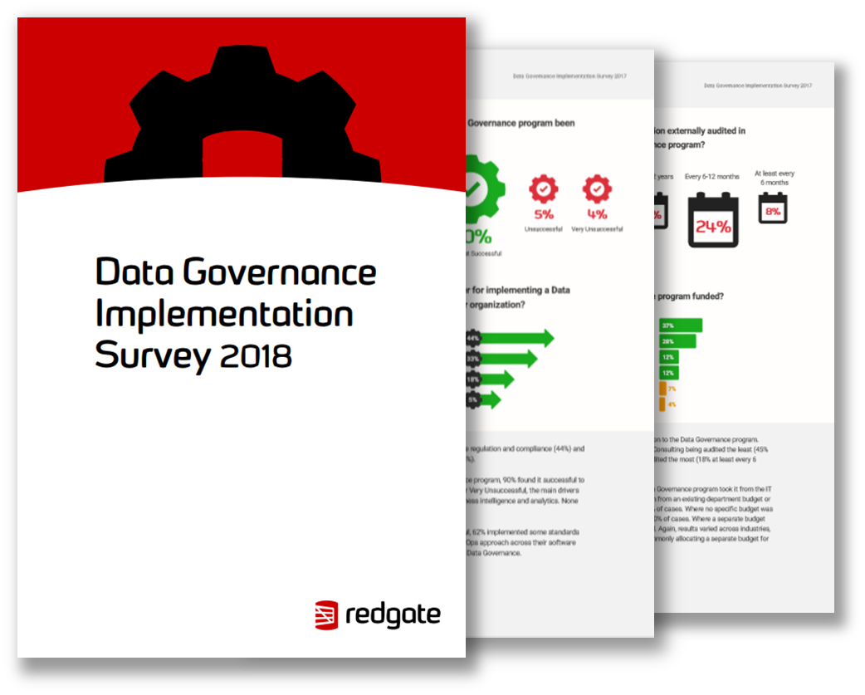
But where is the risk in this process?
Notes:
Well data is an asset, in fact it’s our most precious asset and we need to know that it is being kept safe at every turn, whether this is part of looking after our production systems or even wherever we may be using this data for some other forms of processing.
Redgate recently ran a Data Governance Implementation Survey and in this report over 500 SQL Server professionals responded and gave us an indication of how they handle the technical and business challenges of Data Governance in their organisations which gives us some insight as to how people handle data as part of some of the aforementioned processes we’ve been through today.

Slide 12
Some key findings
72% worked in organizations subject to legislation or regulations such as SOX and HIPAA.
64% said adopting a DevOps approach to their software development was beneficial to their Data Governance program.
Successful and very successful programs used 11 tools on average.
Notes:
As you can see – a lot of people fall under that umbrella of being in a regulated industry or organisation so we have to be treating Data with the correct care and attention it deserves.
In the past I’ve spoken with people who believe that DevOps would have a detrimental impact on their Data Governance programs but actually that couldn’t be further from the truth. Having in place those scalable, automated and repeatable processes means we can audit each stage and bring our good friend Reliability to the party. It’s certainly easier to trace what's happening to data when we know what's happening to it in the first place!
Why does this regulation matter in the database development world though?

Slide 13
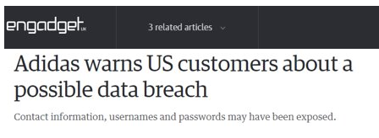

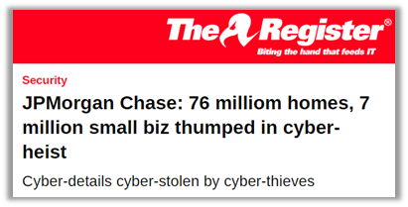
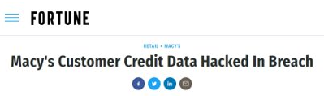
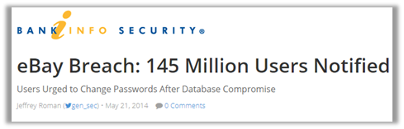

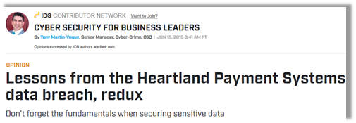
Data Breaches are Headline News
Notes:
Well Data Breaches continue to plague companies, and moving into the new regulated world there are steps we have to take to try to protect our end users. But where are these breaches coming from?

Slide 14
Where do these breaches come from?
92%
External Attackers*
for Finance and Insurance industries
56%
Internal Users*
Healthcare
48%
Hacking attacks*
In all cases
12%
Privilege misuse*
*Study from 2018 Data Breach Investigations Report- Verizon
Notes:
So hacking is still top tactic used, privilege misuse and casual events together are close behind – but this isn't always cracking Production wide open, many times this includes making your way in to a network and sniffing around for a disguarded Backup file or trying to get your hands on a pre-production copy which won't share nearly the same level of water-tight security!
Depending on the vertical your company resides in, it varies where the biggest threats are, and the thing to highlight here is that on the whole, breaches CAN come from anywhere, so really it's up to us as curators of the data, or data controllers/processors, to do our due diligence and ensure that data is protected from the start. That access to data is controlled and where possible, data processing is minimized to only what is relevant and necessary – does that sound familiar? Well it should! It's similar across the board for most data protection legislation.

Slide 15
Number 1 asset involved in Breaches:
Databases
Notes:
Unsurprisingly then it is the Database that is the number 1 asset put at risk when it comes to breaches, and we need to put some steps in place to protect our main asset.

Slide 16
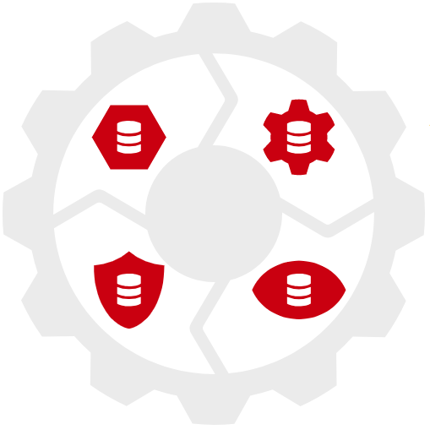




4 Elements of Compliant Database DevOps
Notes:
So what can you do to ensure that your database development process is secure & compliant?
At Redgate, we would recommend you start by looking at these 4 areas, to start your journey to Compliant database DevOps processes. [talk through cog]

Slide 17
A complete database DevOps process
Notes:
This is Regdate’s preferred Database DevOps process and a similar toolchain to the one being adopted at the likes of Skyscanner, as well as Barclays Bank, Fitness First, Yorkshire Water and Merrill Lynch. What you’ll see along the top is the traditional application deployment pipeline, starting from the left where we have developers making changes and committing them into source control etc. And then the bottom line is this protective coating we have to galvanize our pipeline with. [talk through diagram]
Summarize.

